Slide 1


The PiXL Club The PiXL Club The PiXL Club The PiXL Club The PiXL Club The PiXL Club The PiXL Club The PiXL Club The PiXL Club The PiXL Club The PiXL Club The PiXL Club The PiXL Club The PiXL Club The PiXL Club The PiXL Club The PiXL Club The PiXL Club The PiXL Club The PiXL Club The PiXL Club The PiXL Club The PiXL Club The PiXL Club The PiXL Club The PiXL Club The PiXL Club The PiXL Club The PiXL Club The PiXL Club The PiXL Club The PiXL Club The PiXL Club The PiXL Club The PiXL Club The PiXL Club The PiXL Club The PiXL Club The PiXL Club The PiXL Club The PiXL Club The PiXL Club The PiXL Club The PiXL Club The PiXL Club XL Club The PiXL Club The PiXL Club The PiXL Club The PiXL Club The PiXL Club The PiXL Club The PiXL Club The PiXL Club The PiXL Club The PiXL Club The PiXL Club The PiXL Club The PiXL Club The PiXL Club The PiXL Club The PiXL Club The PiXL Club The PiXL Club The PiXL Club The PiXL Club The PiXL Club The PiXL Club The PiXL Club The PiXL Club The PiXL Club The PiXL Club The PiXL Club The PiXL Club The PiXL Club The PiXL Club The PiXL Club The PiXL Club The PiXL Club The PiXL Club The PiXL Club The PiXL Club The PiXL Club The PiXL Club The PiXL Club The PiXL Club The PiXL Club The PiXL Club The PiXL Club The PiXL Club The PiXL Club The PiXL Club The PiXL Club The PiXL Club The PiXL Club The PiXL Club The PiXL Club The PiXL Club The PiXL Club The PiXL Club The PiXL Club The PiXL Club The PiXL Club The PiXL Club The PiXL Club The PiXL Club The PiXL Club The PiXL Club The PiXL Club The PiXL Club The PiXL Club The PiXL Club The PiXL Club The PiXL Club The PiXL Club The PiXL Club The PiXL Club The PiXL Club The PiXL Club The PiXL Club The PiXL Club The PiXL Club The PiXL Club The PiXL Club The PiXL Club The PiXL Club The PiXL Club The PiXL Club The PiXL Club The PiXL Club The PiXL Club The PiXL Club The PiXL Club The PiXL Club The PiXL Club The PiXL Club The PiXL Club The PiXL Club The PiXL Club The PiXL Club The PiXL Club The PiXL Club The PiXL Club The PiXL Club The PiXL Club The PiXL Club The PiXL Club The PiXL Club The PiXL Club The PiXL Club The PiXL Club The PiXL Club The PiXL Club The PiXL Club The PiXL Club The PiXL Club The PiXL Club The PiXL Club The PiXL Club The PiXL Club The PiXL Club The PiXL Club The PiXL Club The PiXL Club The PiXL Club The PiXL Club The PiXL Club The PiXL Club The PiXL Club The PiXL Club The PiXL Club The PiXL Club The PiXL Club The PiXL Club The PiXL Club The PiXL Club The PiXL Club The PiXL Club The PiXL Club The PiXL Club The PiXL Club The PiXL Club The PiXL Club The PiXL Club The PiXL Club The PiXL Club The PiXL Club The PiXL Club The PiXL Club The PiXL Club The PiXL Club The PiXL Club The PiXL Club The PiXL Club The PiXL Club The PiXL Club The PiXL Club The PiXL Club The PiXL Club The PiXL Club The PiXL Club The PiXL Club The PiXL Club The PiXL Club The PiXL Club The PiXL Club The PiXL Club The PiXL Club The PiXL Club The PiXL Club The PiXL Club The PiXL Club The PiXL Club The PiXL Club The PiXL Club The PiXL Club The PiXL Club The PiXL Club The PiXL Club The PiXL Club The PiXL Club The PiXL Club The PiXL Club The PiXL Club The PiXL Club The PiXL Club The PiXL Club The PiXL Club The PiXL Club The PiXL Club The PiXL Club The PiXL Club The PiXL Club The PiXL Club The PiXL Club The PiXL Club The PiXL Club The PiXL Club The PiXL Club The PiXL Club The PiXL Club The PiXL Club The PiXL Club The PiXL Club The PiXL Club The PiXL Club The PiXL Club The PiXL Club The PiXL Club The PiXL Club The PiXL Club The PiXL Club The PiXL Club The PiXL Club The PiXL Club The PiXL Club The PiXL Club The PiXL Club The PiXL Club The PiXL Club The PiXL Club The PiXL Club The PiXL Club The PiXL Club The PiXL Club The PiXL Club The PiXL Club The PiXL Club The PiXL Club The PiXL Club The PiXL Club The PiXL Club The PiXL Club The PiXL Club The PiXL Club The PiXL Club The PiXL Club The PiXL Club The PiXL Club The PiXL Club The PiXL Club The PiXL Club The PiXL Club The PiXL Club The PiXL Club The PiXL Club The PiXL Club The PiXL Club The PiXL Club The PiXL Club The PiXL Club The PiXL Club The PiXL Club The PiXL Club The PiXL Club The PiXL Club The PiXL Club The PiXL Club The PiXL Club The PiXL Club The PiXL Club The PiXL Club The PiXL Club The PiXL Club The PiXL Club The PiXL Club The PiXL Club The PiXL Club The PiXL Club The PiXL Club The PiXL Club The PiXL Club The PiXL Club The PiXL Club The PiXL Club The PiXL Club The PiXL Club The PiXL Club The PiXL Club The PiXL Club The PiXL Club The PiXL Club The PiXL Club The PiXL Club The PiXL Club The PiXL Club The PiXL Club The PiXL Club The PiXL Club The PiXL Club The PiXL Club The PiXL Club The PiXL Club The PiXL Club The PiXL Club The PiXL Club The PiXL Club The PiXL Club The PiXL Club The PiXL Club The PiXL Club The PiXL Club The PiXL Club The PiXL Club The PiXL Club The PiXL Club The PiXL Club The PiXL Club The PiXL Club The PiXL Club The PiXL Club The PiXL Club The PiXL Club The PiXL Club The PiXL Club The PiXL Club The PiXL Club The PiXL Club The PiXL Club The PiXL Club The PiXL Club The PiXL Club The PiXL Club The PiXL Club The PiXL Club The PiXL Club The PiXL Club The PiXL Club The PiXL Club The PiXL Club The PiXL Club The PiXL Club The PiXL Club The PiXL Club The PiXL Club The PiXL Club The PiXL Club The PiXL Club The PiXL Club The PiXL Club The PiXL Club The PiXL Club The PiXL Club The PiXL Club The PiXL Club The PiXL Club The PiXL Club The PiXL Club The PiXL Club The PiXL Club The PiXL Club The PiXL Club The PiXL Club The PiXL Club The PiXL Club The PiXL Club The PiXL Club The PiXL Club The PiXL Club The PiXL Club The PiXL Club The PiXL Club The PiXL Club The PiXL Club The PiXL Club The PiXL Club The PiXL Club The PiXL Club The PiXL Club The PiXL Club The PiXL Club The PiXL Club The PiXL Club The PiXL Club The PiXL Club The PiXL Club The PiXL Club The PiXL Club The PiXL Club The PiXL Club The PiXL Club The PiXL Club The PiXL Club The PiXL Club The PiXL Club The PiXL Club The PiXL Club The PiXL Club The PiXL Club The PiXL Club The PiXL Club The PiXL Club The PiXL Club The PiXL Club The PiXL Club The PiXL Club The PiXL Club The PiXL Club The PiXL Club The PiXL Club The PiXL Club The PiXL Club The PiXL Club The PiXL Club The PiXL Club The PiXL Club The PiXL Club The PiXL Club The PiXL Club The PiXL Club The PiXL Club The PiXL Club The PiXL Club The PiXL Club The PiXL Club The PiXL Club The PiXL Club The PiXL Club The PiXL Club The PiXL Club The PiXL Club The PiXL Club The PiXL Club The PiXL Club The PiXL Club The PiXL Club The PiXL Club The PiXL Club The PiXL Club The PiXL Club The PiXL Club The PiXL Club The PiXL Club The PiXL Club The PiXL Club The PiXL Club The PiXL Club The PiXL Club The PiXL Club The PiXL Club The PiXL Club The PiXL Club The PiXL Club The PiXL Club The PiXL Club The PiXL Club The PiXL Club The PiXL Club The PiXL Club The PiXL Club The PiXL Club The PiXL Club The PiXL Club The PiXL Club The PiXL Club The PiXL Club The PiXL Club The PiXL Club The PiXL Club The PiXL Club The PiXL Club The PiXL Club The PiXL Club The PiXL Club The PiXL Club The PiXL Club The PiXL Club The PiXL Club The PiXL Club The PiXL Club The PiXL Club The PiXL Club The PiXL Club The PiXL Club The PiXL Club The PiXL Club The PiXL Club The PiXL Club The PiXL Club The PiXL Club The PiXL Club The PiXL Club The PiXL Club The PiXL Club The PiXL Club The PiXL Club The PiXL Club The PiXL Club The PiXL Club The PiXL Club The PiXL Club The PiXL Club The PiXL Club The PiXL Club The PiXL Club The PiXL Club The PiXL Club The PiXL Club The PiXL Club The PiXL Club The PiXL Club The PiXL Club The PiXL Club The PiXL Club The PiXL Club The PiXL Club The PiXL Club The PiXL Club The PiXL Club The PiXL Club The PiXL Club The PiXL Club The PiXL Club The PiXL Club The PiXL Club The PiXL Club The PiXL Club The PiXL Club The PiXL Club The PiXL Club The PiXL Club The PiXL Club The PiXL Club The PiXL Club The PiXL Club The PiXL Club The PiXL Club The PiXL Club The PiXL Club The PiXL Club The PiXL Club The PiXL Club The PiXL Club The PiXL Club The PiXL Club The PiXL Club The PiXL Club The PiXL Club The PiXL Club The PiXL Club The PiXL Club The PiXL Club The PiXL Club The PiXL Club The PiXL Club The PiXL Club The PiXL Club The PiXL Club The PiXL Club The PiXL Club The PiXL Club The PiXL Club The PiXL Club The PiXL Club The PiXL Club The PiXL Club The PiXL Club The PiXL Club The PiXL Club The PiXL Club The PiXL Club The PiXL Club The PiXL Club The PiXL Club The PiXL Club The PiXL Club The PiXL Club The PiXL Club The PiXL Club The PiXL Club The PiXL Club The PiXL Club The PiXL Club The PiXL Club The PiXL Club The PiXL Club The PiXL Club The PiXL Club The PiXL Club The PiXL Club The PiXL Club The PiXL Club The PiXL Club The PiXL Club The PiXL Club The PiXL Club The PiXL Club The PiXL Club The PiXL Club The PiXL Club The PiXL Club The PiXL Club The PiXL Club The PiXL Club The PiXL Club The PiXL Club The PiXL Club The PiXL Club The PiXL Club The PiXL Club The PiXL Club The PiXL Club The PiXL Club The PiXL Club The PiXL Club The PiXL Club The PiXL Club The PiXL Club The PiXL Club The PiXL Club The PiXL Club The PiXL Club The PiXL Club The PiXL Club The PiXL Club The PiXL Club The PiXL Club The PiXL Club The PiXL Club The PiXL Club The PiXL Club The PiXL Club The PiXL Club The PiXL Club The PiXL Club The PiXL Club The PiXL Club The PiXL Club The PiXL Club The PiXL Club The PiXL Club The PiXL Club The PiXL Club The PiXL Club The PiXL Club The PiXL Club The PiXL Club The PiXL Club The PiXL Club The PiXL Club The PiXL Club The PiXL Club The PiXL Club The PiXL Club The PiXL Club The PiXL Club The PiXL Club The PiXL Club The PiXL Club The PiXL Club The PiXL Club The PiXL Club The PiXL Club The PiXL Club The PiXL Club The PiXL Club The PiXL Club The PiXL Club The PiXL Club The PiXL Club The PiXL Club The PiXL Club The PiXL Club The PiXL Club The PiXL Club The PiXL Club The PiXL Club The PiXL Club The PiXL Club The PiXL Club The PiXL Club The PiXL Club The PiXL Club The PiXL Club The PiXL Club The PiXL Club The PiXL Club The PiXL Club The PiXL Club The PiXL Club The PiXL Club The PiXL Club The PiXL Club The PiXL Club The PiXL Club The PiXL Club The PiXL Club The PiXL Club The PiXL Club The PiXL Club The PiXL Club The PiXL Club The PiXL Club The PiXL Club The PiXL Club The PiXL Club The PiXL Club The PiXL Club The PiXL Club The PiXL Club The PiXL Club The PiXL Club The PiXL Club The PiXL Club The PiXL Club The PiXL Club
PiXL KnowIT!
GCSE Chemistry
Edexcel Topic – States of matter and mixtures
© Copyright The PiXL Club Ltd, 2017
This resource is strictly for the use of member schools for as long as they remain members of The PiXL Club. It may not be copied, sold nor transferred to a third party or used by the school after membership ceases. Until such time it may be freely used within the member school.
All opinions and contributions are those of the authors. The contents of this resource are not connected with nor endorsed by any other company, organisation or institution.
www.pixl.org.uk The PiXL Club Ltd, Company number 07321607

Slide 2
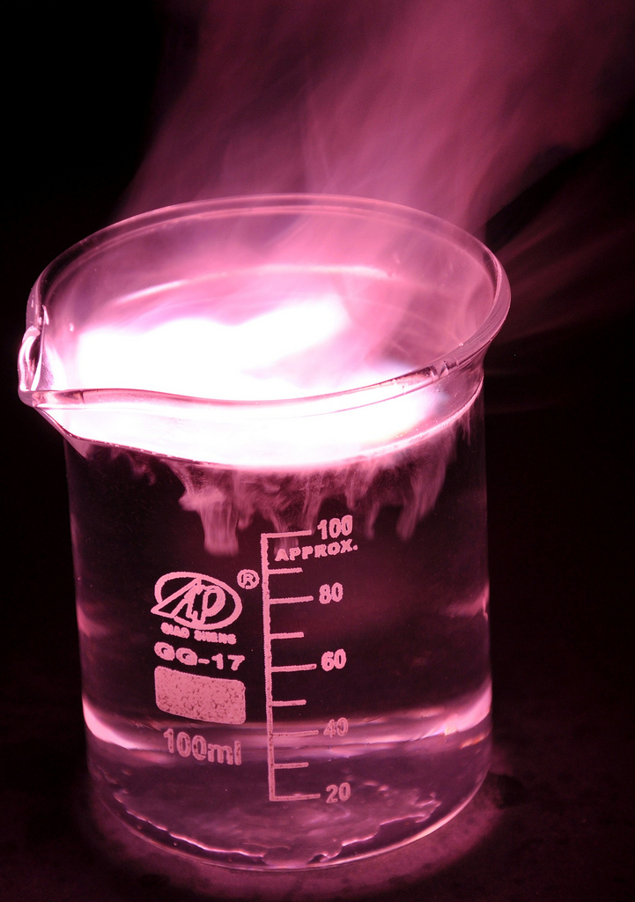
Overview States of matter and mixtures
Changes of state
States of matter
Interconversions between states
Methods of separating and purifying
‘Pure substances’ and melting point data
Methods of separating mixtures
Paper chromatography
Potable water
Ground water
Sea water
Waste water
Notes:
https://c2.staticflickr.com/4/3178/4076380768_03994aed44_b.jpg

Slide 3

LearnIT!
KnowIT!
Changes of State
States of matter

Slide 4
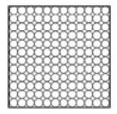
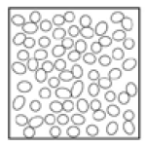
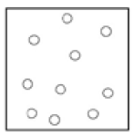
States of matter and state symbols
There are three states of matter – solid, liquid and gas. To explain the properties of the states, the particle theory is used. It is based on the fact that all matter is made up of tiny particles and describes the movement and distance between particles.
Solid | Liquid | Gas
Close together, regular pattern, vibrate on the spot. | Close together, random arrangement, move around each other. | Far apart, random arrangement, move quickly.
In chemical equations, the three states are shown as (s), (l), (g)
and (aq) for aqueous solutions.

Slide 5
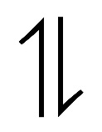
Changes of state
Melting and freezing take place at the melting point.
Boiling and condensing take place at the boiling point.
The amount of energy required to change the state depends on the strength of the forces between the particles of the substance.
The stronger the forces between the particles the higher the melting and boiling point of the substance.
The type of bonding and the structure of the substance depend on the particles involved.
Freezing
Melting
Condensing
Boiling
These are PHYSICAL changes and can easily be reversed, unlike CHEMICAL changes.

Slide 6

QuestionIT!
Changes of State
States of matter

Slide 7
Properties of substances – Part 1 – QuestionIT
What are the three states of matter?
Describe the movement and relative amounts of energy of particles in these three states of matter.
What is used to represent particles in the simple particle model?
What takes place at the melting point?
What takes place at the boiling point?
What factor affects the amount of energy needed to change state?

Slide 8

AnswerIT!
Changes of State
States of matter

Slide 9
Properties of substances – Part 1– QuestionIT
What are the three states of matter?
Solid, liquid, gas.
Describe the movement and relative amounts of energy of particles in these three states of matter.
Solid – vibrate in fixed position, lower energy; liquid – move around each other, higher levels of energy; gas – move freely and randomly, high levels of energy.
What is used to represent particles in the simple particle model?
Small solid spheres.
What takes place at the melting point?
Melting and freezing.
What takes place at the boiling point?
Boiling and condensing.
What factor affects the amount of energy needed to change state?
Forces between molecules.

Slide 10
LearnIT!
KnowIT!
Methods of separating and purifying substances – Part 1
Pure substances

Slide 11
Pure substances and Formulations
In chemistry, a pure substance is a single element or compound not mixed with any other substance.
Learn this definition for the exam
Pure substances have specific melting and boiling temperatures.
These can be used to distinguish pure substances from mixtures.
Melting point of a pure substance
Melting point of an impure substance
In science we would not refer to a substance such as milk as being pure as it is a mixture of a number of different substances.
A mixture consists of two or more elements or compounds not chemically combined together. The chemical properties of each substance in the mixture are unchanged.

Slide 12
QuestionIT!
Methods of separating and purifying substances – Part 1
Pure substances

Slide 13
Pure substances – QuestionIT
What is a pure substance?
How could you distinguish between a pure substance and a mixture?
Why would scientists not call milk pure?

Slide 14
AnswerIT!
Methods of separating and purifying substances – Part 1
Pure substances

Slide 15
Pure substances – AnswerIT
What is a pure substance?
A single element or compound, not mixed with any other substance.
How could you distinguish between a pure substance and a mixture?
The pure substance would have a single melting/boiling point.
Why would scientists not call milk pure?
It contains a mixture of substances.

Slide 16
LearnIT!
KnowIT!
Methods of separating and purifying substances – Part 2
Separating techniques
Chromatography

Slide 17
Atoms, elements, compounds and mixtures - PART 2
A mixture consists of two or more elements or compounds not chemically combined together. The chemical properties of each substance in the mixture are unchanged.
Solvent | the liquid in which a solute dissolves
Solute | the substance that dissolves in a liquid to form a solution
Solution | is the mixture formed when a solute has dissolved in a solvent
Soluble | describes a substance that will dissolve
Insoluble | describes a substance that will not dissolve
Mixtures can be separated by physical processes including:
Filtration
Crystallisation
Simple distillation
Fractional distillation
Chromatography
These physical processes do not involve chemical reactions and no new substances are made.
FILTRATION: This technique separates substances that are insoluble in a solvent from those that are soluble

Slide 18
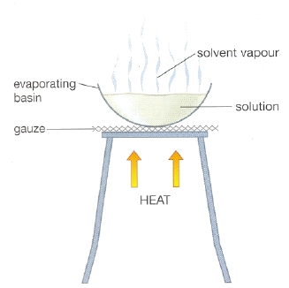
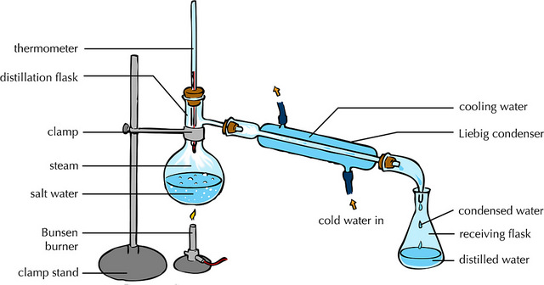
Atoms, elements, compounds and mixtures - PART 2
Crystallisation Simple distillation
This technique separates a soluble substance from a solvent by evaporation
This technique separates a liquid from a mixture by evaporation, followed by condensation
Example - crystallisation of sodium chloride from salt solution
Example - obtaining water from sea water

Slide 19
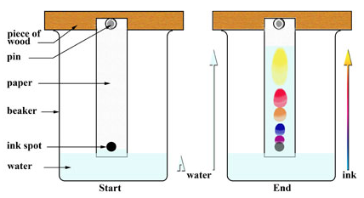
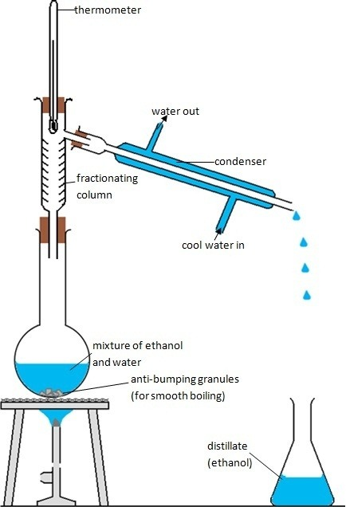
Atoms, elements, compounds and mixtures - PART 2
Fractional distillation Chromatography
This technique separates a mixture into a number of different parts, called fractions. Substances with high boiling points condense at the bottom and substances with low boiling points condense at the top.
Fractional distillation works because the different substances in the mixture have different boiling points.
This technique separates mixtures of soluble substances.
Example - obtaining ethanol from a mixture of ethanol and water
Example - separating the different colours in ink
Notes:
https://qph.ec.quoracdn.net/main-qimg-171088c70ca34c66600fb6b1a115fc62-c
http://www.micromountain.com/sci_diagrams/sci_app/sci_app_assets/ctography_lab_eng.jpg

Slide 20
Chromatography
Position solvent reaches
Chromatography can be used to separate mixtures of soluble substances by running a solvent (mobile phase) through the mixture on the paper (stationary phase) causing the substances to move at different rates.
Parts of mixture separated
The ratio of the distance moved by a compound (centre of spot from origin) can be expressed as its R_{f} value:
R_{f} = distance moved by substance
distance moved by solvent
When calculating the R_{f} value, remember the solvent will always travel further than the substance so the R_{f} value can never be greater than 1.
Mixture to be separated
Solvent
Different compounds have different Rf values in different solvents, which can be used to help identify the compounds. A pure compound will produce a single spot in all solvents.

Slide 21
QuestionIT!
Methods of separating and purifying substances – Part 2
Separating techniques
Chromatography

Slide 22
Mixtures – QuestionIT
What is the difference between a compound and a mixture?
Describe the method used to collect the salt from a mixture of sand and salt.
What process is used to purify seawater to obtain usable water?

Slide 23
Mixtures – QuestionIT
4. Describe how the following equipment is used to separate water
and ethanol.

Slide 24
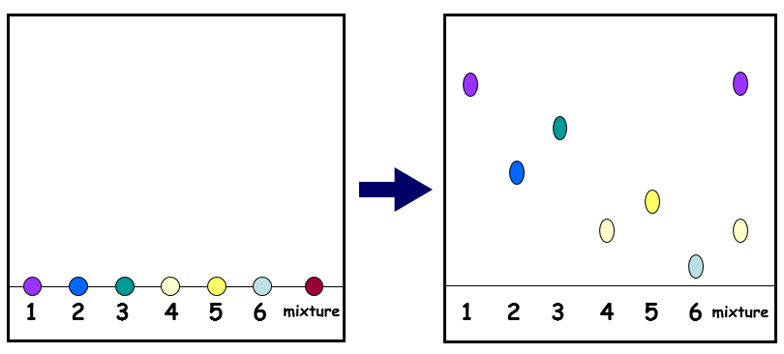
Mixtures – QuestionIT
A mixture and six colours are tested using chromatography. The following chromatogram was produced.
a) What can you conclude about the mixture?
b) Why do the inks separate?

Slide 25
Mixtures – QuestionIT
6. What is chromatograph?
7. What happens in the stationary and mobile phases?
8. A solvent travels 8cm up the stationary phase; two spots separate out. A travels 6cm up the mobile phase, B travels 4.5cm up the mobile phase. Give the Rf value for both, to two decimal places.

Slide 26
AnswerIT!
Methods of separating and purifying substances – Part 2
Separating techniques
Chromatography

Slide 27
Mixtures – AnswerIT
What is the difference between a compound and a mixture?
The substances in a mixture are not chemically bonded together,
but they are in a compound.
2. Describe the method used to collect the salt from a mixture of
sand and salt.
Add water and stir to dissolve the salt. Use filtration to remove
the sand. Heat the water (gently) to allow the salt to crystallise
(to avoid dryness).
3. What process is used to purify seawater to obtain usable water?
Simple distillation

Slide 28
Mixtures – AnswerIT
4. Describe how the following equipment is used to separate water
and ethanol.
The ethanol and water mixture are heated. Ethanol has a boiling point of 78°C and will vaporise first. The gas passes over the fractionating column and into the condenser. Here it will condense, turning back into it’s liquid state.

Slide 29
Mixtures – AnswerIT
A mixture and six colours are tested using chromatography. The following chromatogram was produced:
a) What can you conclude about the mixture?
The mixture is made up from substance 1 and 4.
b) Why do the inks separate to produce a chromatogram?
The separation depends on how soluble the chemical is in the
solvent and how strongly the chemical is attracted to the paper.

Slide 30
Mixtures – AnswerIT
6. What is chromatograph?
It is used to separate mixtures and helps identify substances.
7. What happens in the stationary and mobile phases?
The stationary phase is the material that the mixture moves up through, the mobile phase is the movement of the mixture in the solvent.
8. A solvent travels 8cm up the stationary phase; two spots separate out. A travels 6cm up the mobile phase, B travels 4.5cm up the mobile phase. Give the Rf value for both to two decimal places.
A = 0.75, B= 0.56

Slide 31
LearnIT!
KnowIT!
Methods of separating and purifying substances – Part 3
Waste and ground water treatment
Sea water treatment

Slide 32
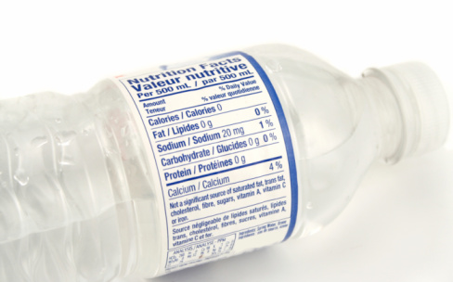
Potable water
Water used in chemical analysis must not contain any dissolved salts.
Water that is safe to drink is called potable water. Potable water is not pure water in the chemical sense because it contains dissolved substances.

Slide 33

Potable water
The methods used to produce potable water depend on available supplies of water and local conditions.
In the United Kingdom (UK), rain provides water with low levels of dissolved substances (fresh water) that collects in the ground and in lakes and rivers.
Most potable water is produced by;
choosing an appropriate source of fresh water
sedimentation
passing the water through filter beds
chlorination.

Slide 34
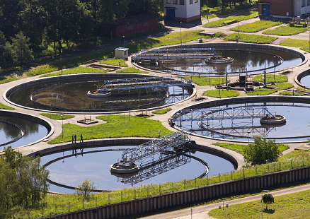
Waste water treatment
Urban lifestyles and industrial processes produce large amounts of waste water that require treatment before being released into the environment.
Sewage and agricultural waste water require removal of
organic matter
harmful microbes.
Industrial waste water may require removal of
organic matter
harmful chemicals.
Sewage treatment includes
filtration and grit removal
sedimentation to produce sewage sludge and effluent
chlorination to kill bacteria.

Slide 35
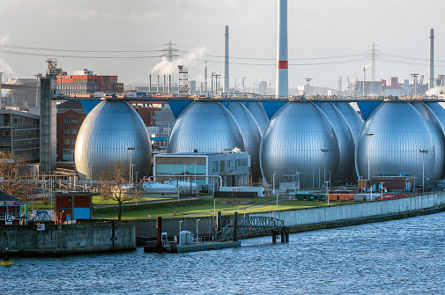
Potable water
If supplies of fresh water are limited, desalination of salty water or sea water may be required. Desalination can be done by distillation.
Desalination requires large amounts of energy
Desalination by distillation in Hamburg Germany

Slide 36
QuestionIT!
Methods of separating and purifying substances – Part 3
Waste and ground water treatment
Sea water treatment

Slide 37
Potable water - QuestionIT
Why is potable water not described as pure water by scientists?
What does the method used to produce potable water depend upon?
How is most potable water in the UK produced?
What method can be used for the desalination of salty water?
What needs to be removed from sewage and agricultural waste water?
What are the three stages in the treatment of sewage?

Slide 38
AnswerIT!
Methods of separating and purifying substances – Part 3
Waste and ground water treatment
Sea water treatment

Slide 39
Potable water - QuestionIT
Why is potable water not described as pure water by scientists?
It contains dissolved substances.
What does the method used to produce potable water depend upon?
Availability of supplies and local conditions.
How is most potable water in the UK produced?
Choosing suitable fresh water, sedimentation, filtering and chlorination.
What method can be used for the desalination of salty water?
Distillation.
What needs to be removed from sewage and agricultural waste water?
Organic matter and harmful microbes.
What are the three stages in the treatment of sewage?
Sedimentation, filtration, chlorination.

